Slide 1

Spam Email Filter - Machine Learning Model

Slide 2
Agenda
01
02
03
04
05
06
Business Problem
Exploratory Data Analysis
Predictive Modeling
Conclusions
Recommendation
Next Steps

Slide 3

Business Problem
01
Our telecommunications company wants to break into the email market and needs to implement an effective SPAM filter.
We are charged with:
Create a model that reliably detects SPAM in a way that will maximize customer satisfaction

Slide 4

Data Analysis
02
Actual emails in the form of individual HTML files were used in the analysis
Source: Index of /old/publiccorpus (apache.org)
5825 HTML files in total
Each email was previously labeled as HAM or SPAM and sorted into folders

Slide 5
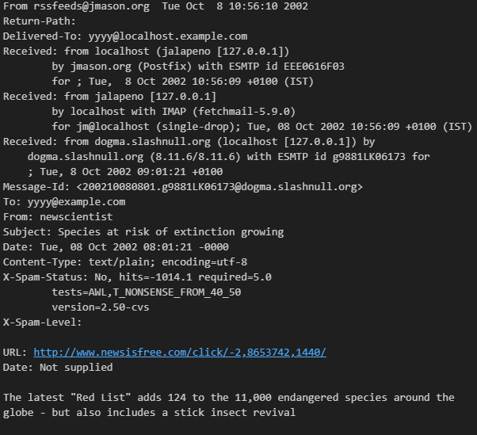
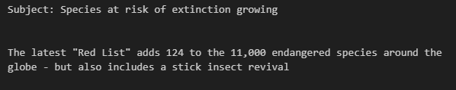
Email Importing and Preprocessing

Slide 6
Subject Line vs Email Body
Subject Line:
- We expect ‘dense’ information about the nature of the email
Email Body:
- More information about the nature of the email, more verbose
Modeling the Subject and Body separately…

Slide 7
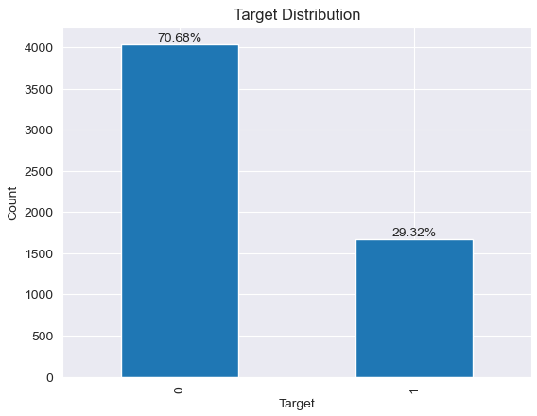
Target Distribution Imbalance

Slide 8
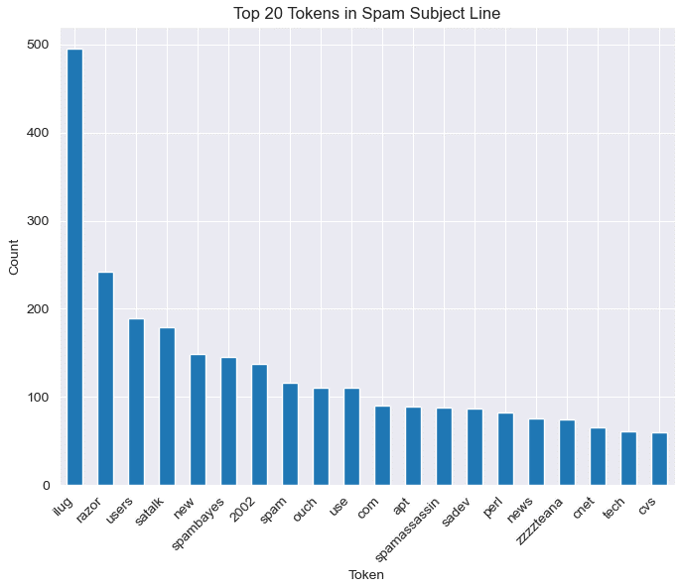
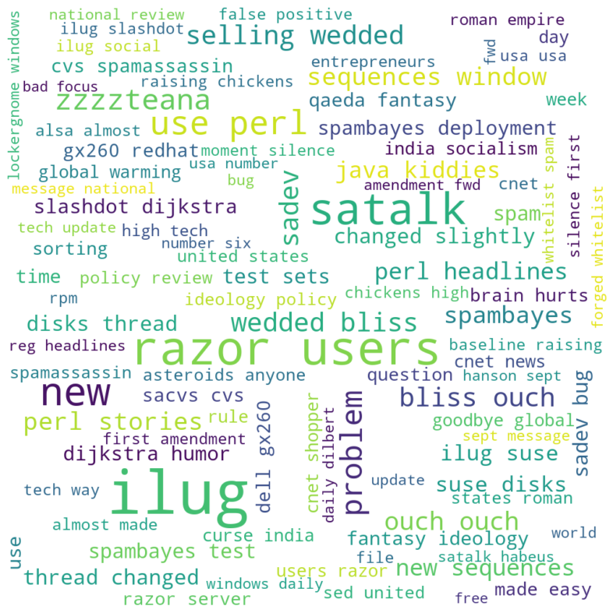
Subject Line EDA – Ham Class
Token Histogram
Word Cloud Top 100
Note: Models are built on company internal ‘jargonized’ email data, will need to adjust models trained on anonymized customer emails data after deployment

Slide 9
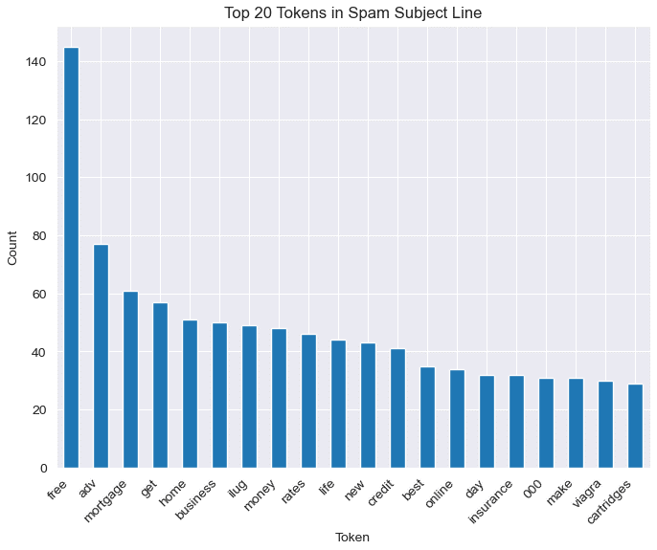
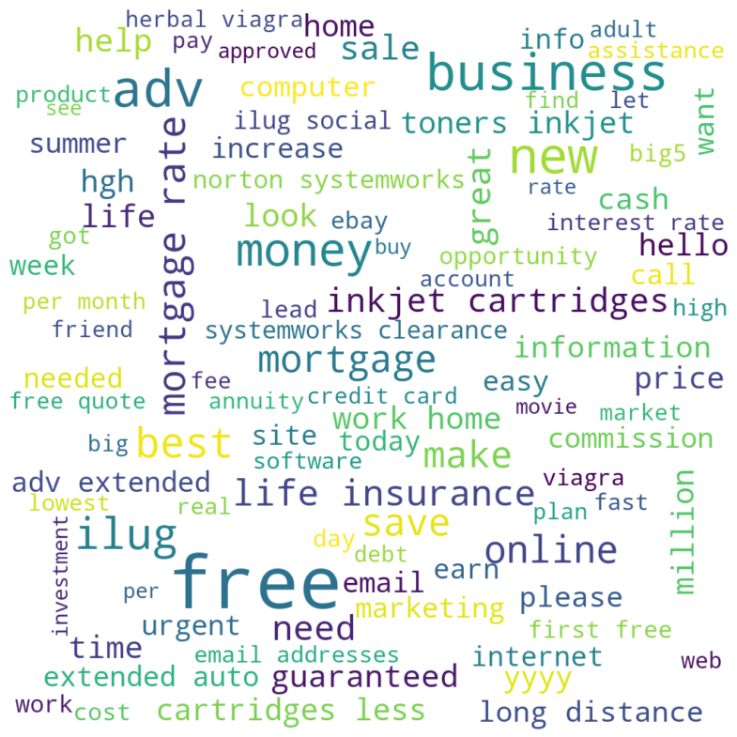
Subject Line EDA – Spam Class
Token Histogram
Word Cloud Top 100

Slide 10

Predictive Modeling
03
BUSINESS REQUIREMENT:
Getting SPAM in the inbox irritates our customers, but missing an important message because we classified it as SPAM will really anger them!
Optimizing models on Precision (minimize False-Pos), then Accuracy
Less than 1% of customers HAM emails are allowed to go to the SPAM classification

Slide 11
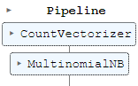
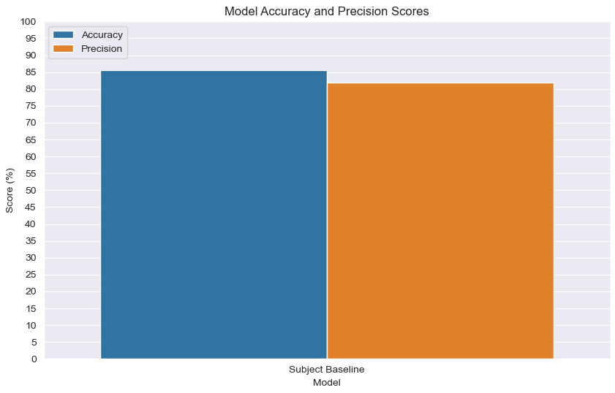
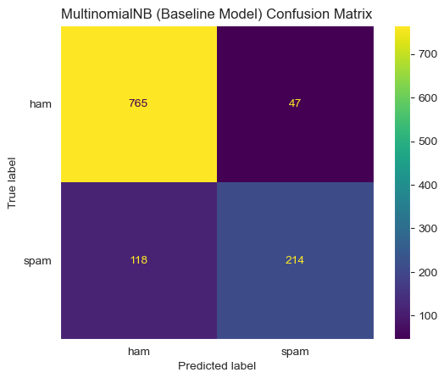
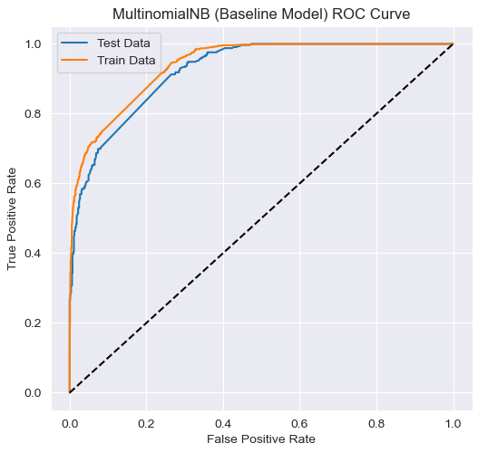
Subject Line Baseline Model
Regex tokenizer of >2 characters
Binary vectorizer
Multinomial Bayes Classifier
86%
82%

Slide 12
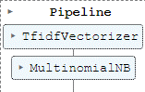
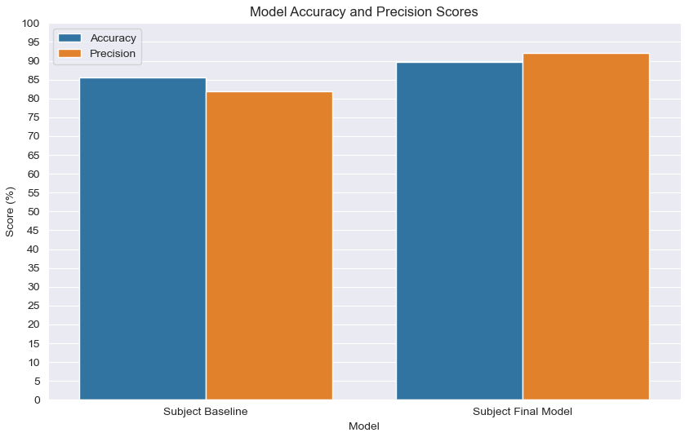
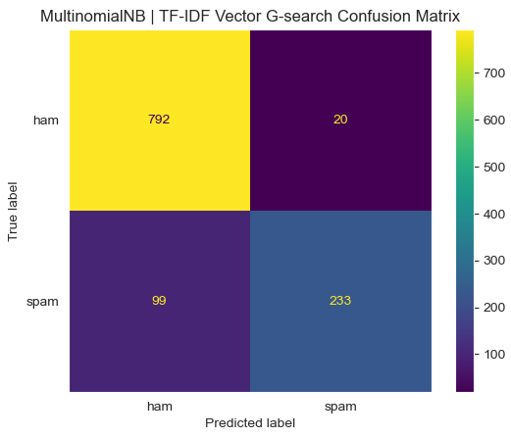
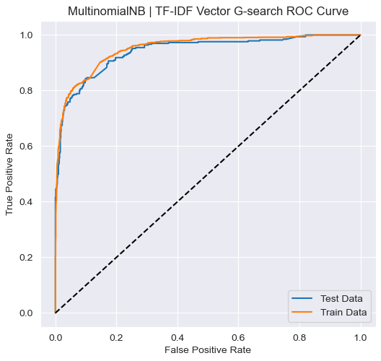
Subject Line Final Model
Word_punct_tokenizer
TFIDF vectorizer
Multinomial Bayes Classifier
90%
92%

Slide 13
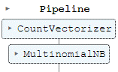
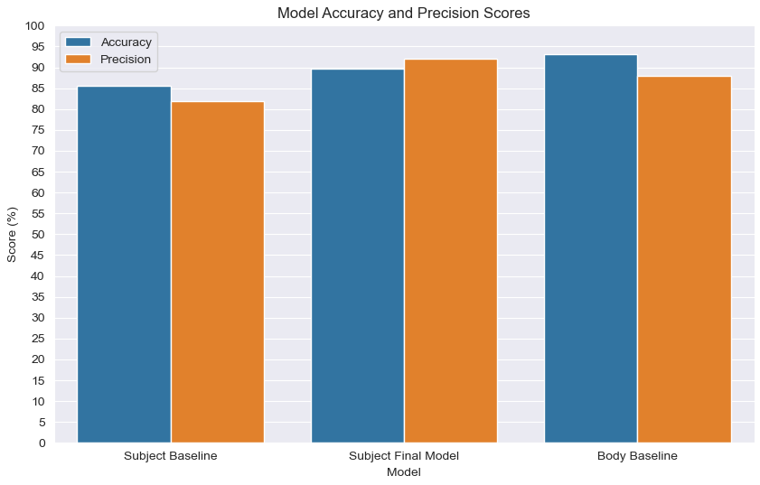
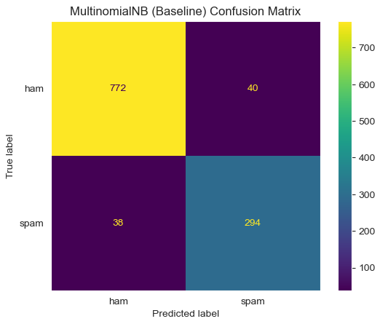
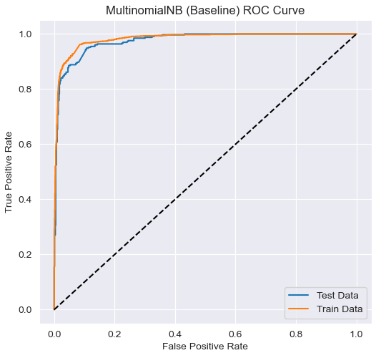
Email Body Baseline Model
Regex tokenizer of >2 characters
Binary vectorizer
Multinomial Bayes Classifier
93%
88%

Slide 14
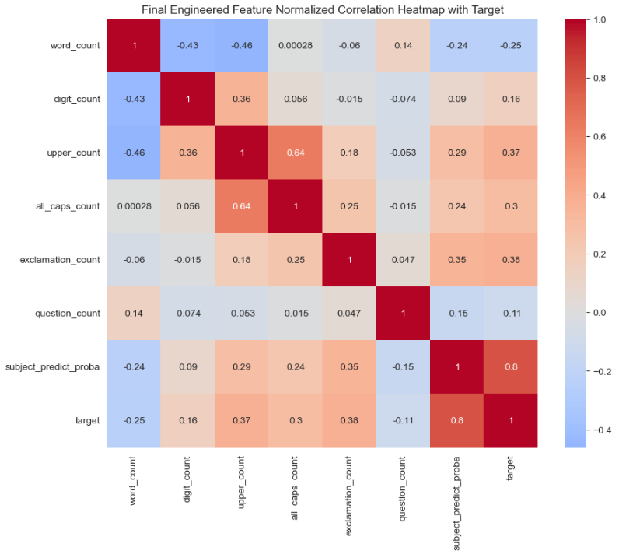
Email Body Feature Engineering
SUBJECT LINE PREDICTIONS

Slide 15
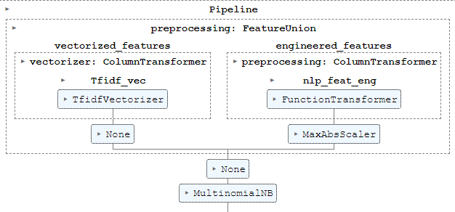
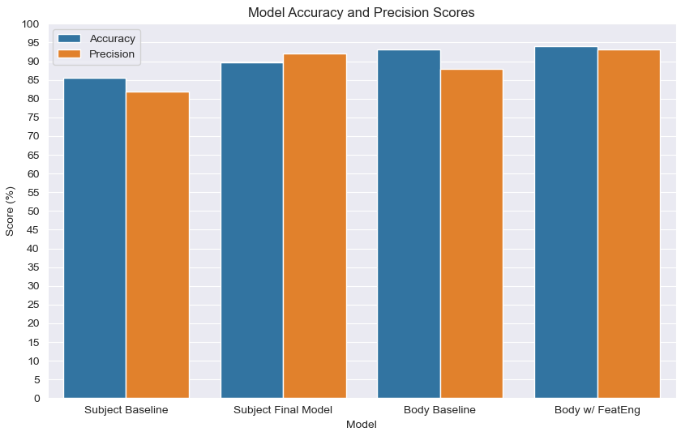
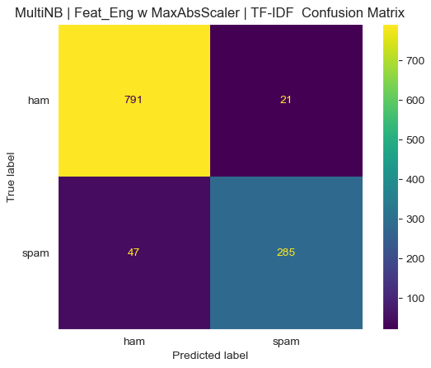
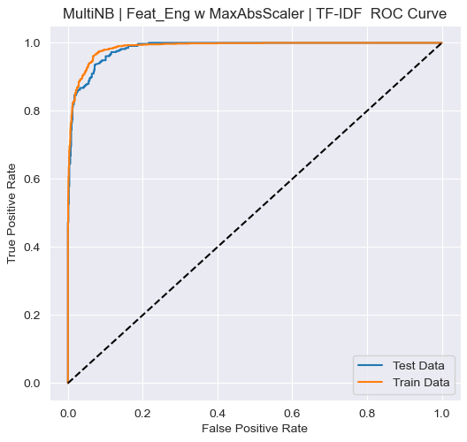
Email Body With Feature Engineering
Regex tokenizer of >2 characters
TF-IDF vectorizer
Multinomial Bayes Classifier
94%
82%

Slide 16
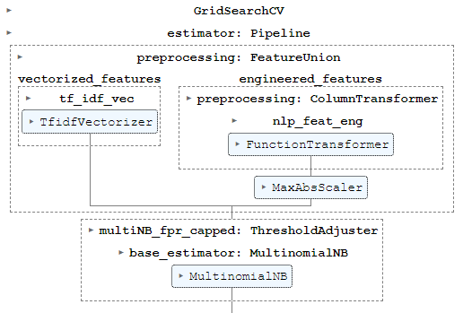
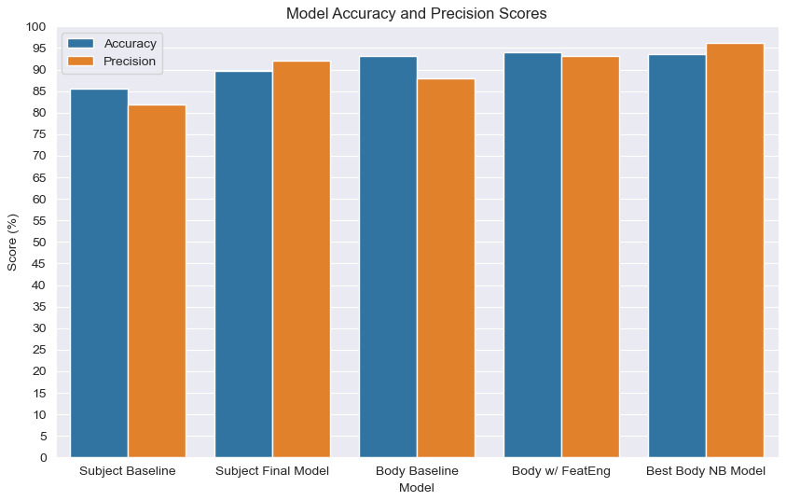
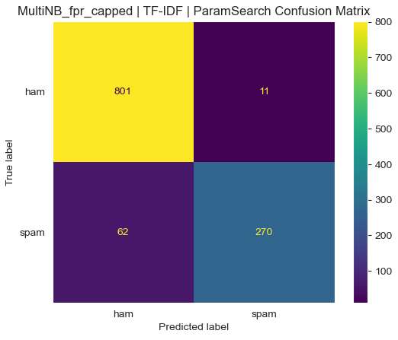
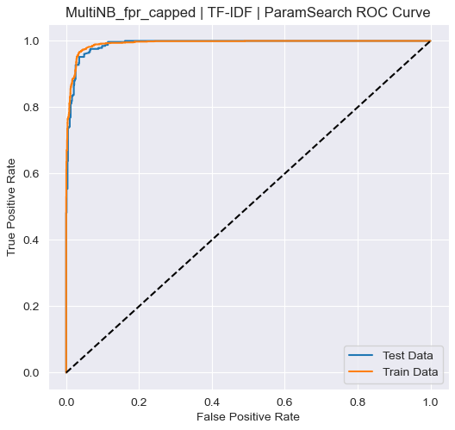
Email Body – Best Naive Bayes Model
Hyperparameter Gridsearch
NB Model wrapped in Prob Threshold Adjuster (<1% FPR)
94%
96%

Slide 17
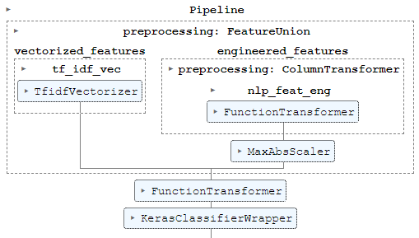
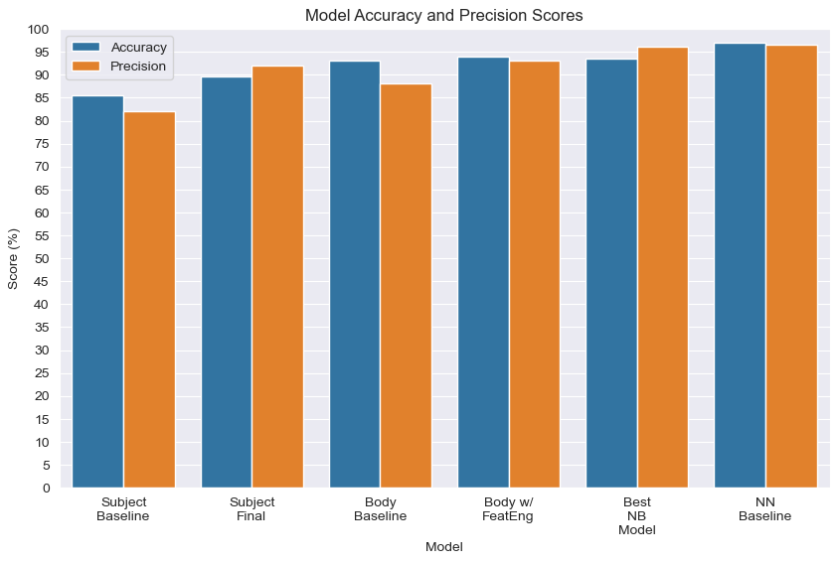
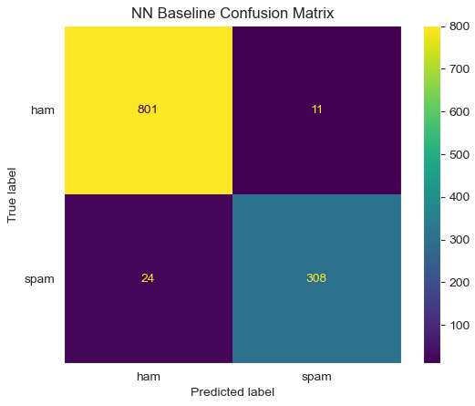
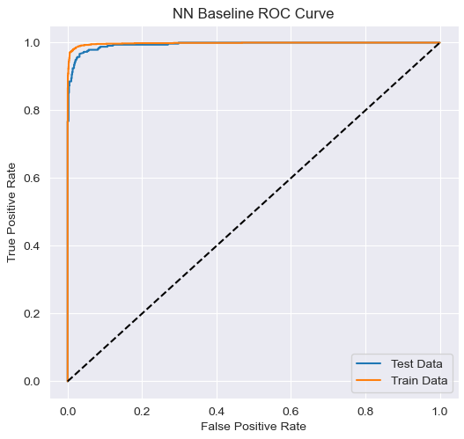
Email Body – Neural Network Baseline
One hidden layer
Threshold Adjusted (<1% FPR)
97%
96%

Slide 18
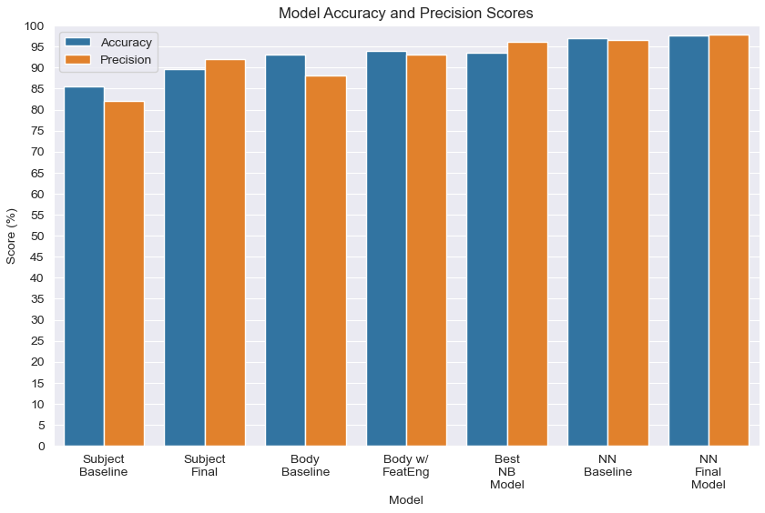
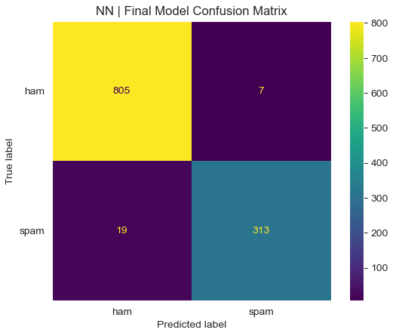
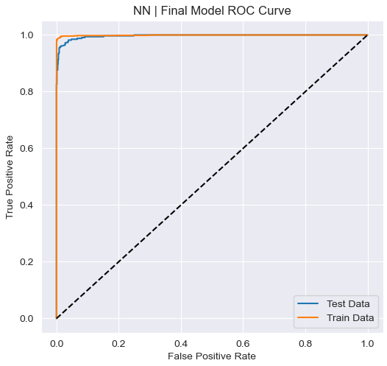
Email Body – Neural Network Final
5 hidden layers
2 dropout layers
Gridsearch using Hyperband()
Prob Threshold Adjusted (<1% FPR)
98%
98%

Slide 19
Conclusion
04
Final Model Test Metrics:
Precision: 97.7%
Accuracy: 97.8%
Final Business Metrics:
False Pos Rate (HAM going to SPAM): 0.9%
False Neg Rate (SPAM going to HAM): 6%

Slide 20

Recommendation
05
Implement the best Neural Network model during initial Email service rollout
Continue to retrain and retune the models on new anonymized customer data
Investigate other potential model improvements (see next steps)

Slide 21
Next Steps
06
Continue to improve the model
Rerun and tune the models with the ‘Cheat words’ removed
Investigate tokenizing based on wordcloud algorithm
Check other model architectures (RandomForest, XGBoost)
Tune NN for subject-line only, perhaps effective and more efficient
Investigate verbiage and nature of SPAM, are there features we can capture
Investigate the False cases; are there features we can capture
Investigate keeping URLs instead of scrubbing them preprocess
Acquire larger data sets of up-to-date emails

Slide 22



Thanks!
Questions? Please contact me at:
Dale DeFord
daledeford@gmail.com

